Slide 2
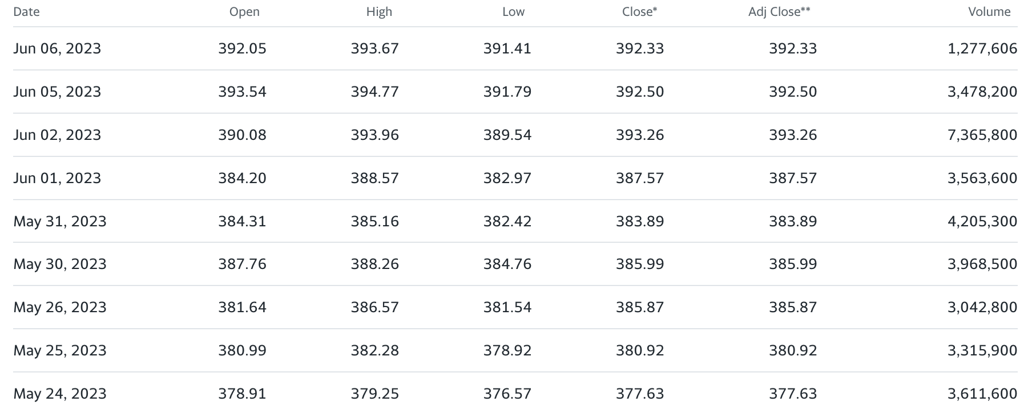
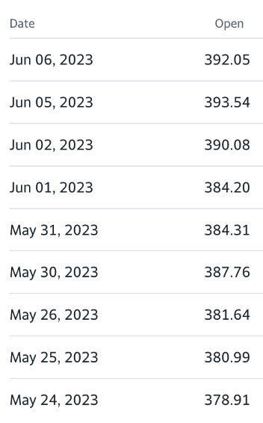
Method – preprocessing (filter)
Vanguard 500 Index Fund (VOO)
Multivariate Time Series of VOO
Univariate Time Series of VOO

Slide 3
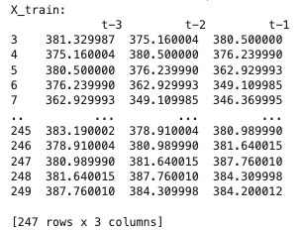
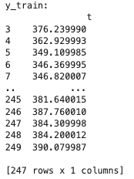
Method – preprocessing (solve TS problem using a ML method)
y train
Univariate Time Series of VOO
X train
Supervised Machine Learning

Slide 4
Method – mlp model
[samples, timesteps]
Supervised Machine Learning
Dense (100)
Dense (1)
adam, mse
Regression
Sequential
Univariate Uni-step MLP Model
Output
Notes:
Denote the following from PAPER: Deep learning for time series classification: a review by Hassan Ismail Fawaz et al, 2019
Discriminative layer
Cost/Loss function
Inference
Generalization

Slide 5
Supervised Machine Learning
Method – cnn model
Univariate Uni-step CNN Model
Output
MaxPooling1D (pool_size=2)
Dense (forecasting_step)
adam, mse
Regression
Conv1D (filters=64)
Flatten
Dense (50, relu)
Sequential
Notes:
Denote the following from PAPER: Deep learning for time series classification: a review by Hassan Ismail Fawaz et al, 2019
Discriminative layer
Cost/Loss function
Inference
Generalization

Slide 6
Method – lstm model
[prior_observations, n_features]
X_input shape = [samples, timesteps, features]
Dense (forecasting_step)
Supervised Machine Learning
LSTM (50, relu)
adam, mse
Regression
Sequential
Univariate Uni-step lstm Model
Output
Notes:
Denote the following from PAPER: Deep learning for time series classification: a review by Hassan Ismail Fawaz et al, 2019
Discriminative layer
Cost/Loss function
Inference
Generalization

Slide 7
Method - model
Regression
MSE
Output
Error

Slide 8
With Darian

Slide 9
MLP
To understand layers: https://youtu.be/qFJeN9V1ZsI?t=1199

Slide 10
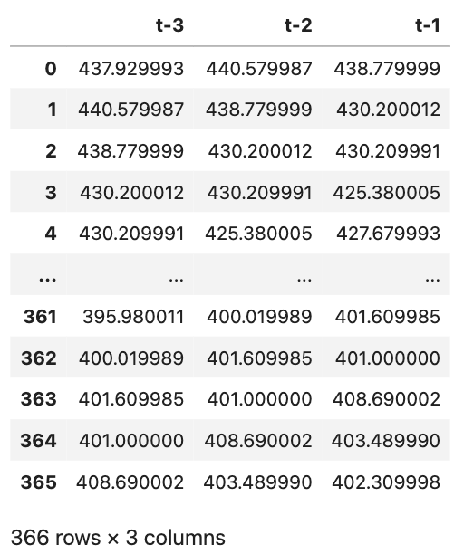
Inputs
(1 x 3)
Weights
(3 x 4)
Hidden
(4 nodes)
Weights
(4 x 1)
Output
(1 node)
MLP
Notes:
Weights (3 x 4)
3: We have 3 input nodes
4: We have 4 nodes in the 1st hidden layer
Weights (4 x 1)
4: We have 4 nodes in the previous layer
1: We have 1 node in the 2nd hidden layer. We have 1 in the 2nd hidden layer because we want to forecast only 1 step ahead

Slide 11
Inputs
(1 x 3)
Weights
(3 x 4)
Hidden
(4 nodes)
Weights
(4 x 1)
Output
(1 node)
437.929993
440.579987
MLP
438.779999
Notes:
Weights (3 x 4)
3: We have 3 input nodes
4: We have 4 nodes in the 1st hidden layer
Weights (4 x 1)
4: We have 4 nodes in the previous layer
1: We have 1 node in the 2nd hidden layer. We have 1 in the 2nd hidden layer because we want to forecast only 1 step ahead

Slide 12
Inputs
(1 x 3)
Weights
(3 x 4)
Hidden
(4 nodes)
Weights
(4 x 1)
Output
(1 node)
437.929993
440.579987
MLP
438.779999
Notes:
Weights (3 x 4)
3: We have 3 input nodes
4: We have 4 nodes in the 1st hidden layer
Weights (4 x 1)
4: We have 4 nodes in the previous layer
1: We have 1 node in the 2nd hidden layer. We have 1 in the 2nd hidden layer because we want to forecast only 1 step ahead

Slide 13
Inputs
(1 x 3)
Weights
(3 x 4)
Hidden
(4 nodes)
Weights
(4 x 1)
Output
(1 node)
437.929993
440.579987
MLP
438.779999
Notes:
Weights (3 x 4)
3: We have 3 input nodes
4: We have 4 nodes in the 1st hidden layer
Weights (4 x 1)
4: We have 4 nodes in the previous layer
1: We have 1 node in the 2nd hidden layer. We have 1 in the 2nd hidden layer because we want to forecast only 1 step ahead

Slide 14
Inputs
(1 x 3)
Weights
(3 x 4)
Hidden
(4 nodes)
Weights
(4 x 1)
Output
(1 node)
437.929993
440.579987
MLP
438.779999
Notes:
Weights (3 x 4)
3: We have 3 input nodes
4: We have 4 nodes in the 1st hidden layer
Weights (4 x 1)
4: We have 4 nodes in the previous layer
1: We have 1 node in the 2nd hidden layer. We have 1 in the 2nd hidden layer because we want to forecast only 1 step ahead

Slide 15
Inputs
(1 x 3)
Weights
(3 x 4)
Hidden
(4 nodes)
Weights
(4 x 1)
Output
(1 node)
437.929993
440.579987
MLP
438.779999
(1 x 3) dot (3 x 4) => (1 x 4)
Notes:
Weights (3 x 4)
3: We have 3 input nodes
4: We have 4 nodes in the 1st hidden layer
Weights (4 x 1)
4: We have 4 nodes in the previous layer
1: We have 1 node in the 2nd hidden layer. We have 1 in the 2nd hidden layer because we want to forecast only 1 step ahead

Slide 16
Inputs
(1 x 3)
Weights
(3 x 4)
Hidden
(4 nodes)
Weights
(4 x 1)
Output
(1 node)
437.929993
440.579987
MLP
438.779999
(1 x 3) dot (3 x 4) => (1 x 4)
Notes:
Weights (3 x 4)
3: We have 3 input nodes
4: We have 4 nodes in the 1st hidden layer
Weights (4 x 1)
4: We have 4 nodes in the previous layer
1: We have 1 node in the 2nd hidden layer. We have 1 in the 2nd hidden layer because we want to forecast only 1 step ahead

Slide 17
Inputs
(1 x 3)
Weights
(3 x 4)
Hidden
(4 nodes)
Weights
(4 x 1)
Output
(1 node)
437.929993
440.579987
MLP
438.779999
(1 x 3) dot (3 x 4) => (1 x 4)
Notes:
Weights (3 x 4)
3: We have 3 input nodes
4: We have 4 nodes in the 1st hidden layer
Weights (4 x 1)
4: We have 4 nodes in the previous layer
1: We have 1 node in the 2nd hidden layer. We have 1 in the 2nd hidden layer because we want to forecast only 1 step ahead

Slide 18
Inputs
(1 x 3)
Weights
(3 x 4)
Hidden
(4 nodes)
Weights
(4 x 1)
Output
(1 node)
437.929993
440.579987
MLP
438.779999
(1 x 3) dot (3 x 4) => (1 x 4)
(1 x 4) dot (4 x 1) => (1 x 1)
Notes:
Weights (3 x 4)
3: We have 3 input nodes
4: We have 4 nodes in the 1st hidden layer
Weights (4 x 1)
4: We have 4 nodes in the previous layer
1: We have 1 node in the 2nd hidden layer. We have 1 in the 2nd hidden layer because we want to forecast only 1 step ahead

Slide 19
Inputs
(1 x 3)
Weights
(3 x 4)
Hidden
(4 nodes)
Weights
(4 x 1)
Output
(1 node)
437.929993
440.579987
MLP
438.779999
(1 x 3) dot (3 x 4) => (1 x 4)
(1 x 4) dot (4 x 1) => (1 x 1)
(1 x 1)
Notes:
Weights (3 x 4)
3: We have 3 input nodes
4: We have 4 nodes in the 1st hidden layer
Weights (4 x 1)
4: We have 4 nodes in the previous layer
1: We have 1 node in the 2nd hidden layer. We have 1 in the 2nd hidden layer because we want to forecast only 1 step ahead

Slide 20
CNN
To understand layers: https://youtu.be/qFJeN9V1ZsI?t=1199

Slide 21
Max
Flatten
=> 440.579987
=> 440.579987
440.579987
=> 440.579987
438.779999
=> 438.779999
(3 x 1)

Slide 22
*
*
=
+
=
### ###
*
OR
440...
=
Max
+
880...
440...

Slide 23
Max
Flatten
=> 440.579987
=> 440.579987
440.579987
=> 440.579987
438.779999
=> 438.779999
(3 x 1)

Slide 24
Ignore the coming slides. They are based on MLP

Slide 25
Inputs
(1 x 3)
Weights
(3 x 4)
Conv1D
(5 nodes)
Weights
(4 x 1)
Output
(1 node)
CNN
Notes:
Weights (3 x 4)
3: We have 3 input nodes
4: We have 4 nodes in the 1st hidden layer
Weights (4 x 1)
4: We have 4 nodes in the previous layer
1: We have 1 node in the 2nd hidden layer. We have 1 in the 2nd hidden layer because we want to forecast only 1 step ahead

Slide 26
Inputs
(1 x 3)
Weights
(3 x 4)
Hidden
(4 nodes)
Weights
(4 x 1)
Output
(1 node)
437.929993
440.579987
CNN
438.779999
Notes:
Weights (3 x 4)
3: We have 3 input nodes
4: We have 4 nodes in the 1st hidden layer
Weights (4 x 1)
4: We have 4 nodes in the previous layer
1: We have 1 node in the 2nd hidden layer. We have 1 in the 2nd hidden layer because we want to forecast only 1 step ahead

Slide 27
Inputs
(1 x 3)
Weights
(3 x 4)
Hidden
(4 nodes)
Weights
(4 x 1)
Output
(1 node)
437.929993
440.579987
CNN
438.779999
Notes:
Weights (3 x 4)
3: We have 3 input nodes
4: We have 4 nodes in the 1st hidden layer
Weights (4 x 1)
4: We have 4 nodes in the previous layer
1: We have 1 node in the 2nd hidden layer. We have 1 in the 2nd hidden layer because we want to forecast only 1 step ahead

Slide 28
Inputs
(1 x 3)
Weights
(3 x 4)
Hidden
(4 nodes)
Weights
(4 x 1)
Output
(1 node)
437.929993
440.579987
CNN
438.779999
Notes:
Weights (3 x 4)
3: We have 3 input nodes
4: We have 4 nodes in the 1st hidden layer
Weights (4 x 1)
4: We have 4 nodes in the previous layer
1: We have 1 node in the 2nd hidden layer. We have 1 in the 2nd hidden layer because we want to forecast only 1 step ahead

Slide 29
Inputs
(1 x 3)
Weights
(3 x 4)
Hidden
(4 nodes)
Weights
(4 x 1)
Output
(1 node)
437.929993
440.579987
CNN
438.779999
Notes:
Weights (3 x 4)
3: We have 3 input nodes
4: We have 4 nodes in the 1st hidden layer
Weights (4 x 1)
4: We have 4 nodes in the previous layer
1: We have 1 node in the 2nd hidden layer. We have 1 in the 2nd hidden layer because we want to forecast only 1 step ahead

Slide 30
Inputs
(1 x 3)
Weights
(3 x 4)
Hidden
(4 nodes)
Weights
(4 x 1)
Output
(1 node)
437.929993
440.579987
CNN
438.779999
(1 x 3) dot (3 x 4) => (1 x 4)
Notes:
Weights (3 x 4)
3: We have 3 input nodes
4: We have 4 nodes in the 1st hidden layer
Weights (4 x 1)
4: We have 4 nodes in the previous layer
1: We have 1 node in the 2nd hidden layer. We have 1 in the 2nd hidden layer because we want to forecast only 1 step ahead

Slide 31
Inputs
(1 x 3)
Weights
(3 x 4)
Hidden
(4 nodes)
Weights
(4 x 1)
Output
(1 node)
437.929993
440.579987
CNN
438.779999
(1 x 3) dot (3 x 4) => (1 x 4)
Notes:
Weights (3 x 4)
3: We have 3 input nodes
4: We have 4 nodes in the 1st hidden layer
Weights (4 x 1)
4: We have 4 nodes in the previous layer
1: We have 1 node in the 2nd hidden layer. We have 1 in the 2nd hidden layer because we want to forecast only 1 step ahead

Slide 32
Inputs
(1 x 3)
Weights
(3 x 4)
Hidden
(4 nodes)
Weights
(4 x 1)
Output
(1 node)
437.929993
440.579987
CNN
438.779999
(1 x 3) dot (3 x 4) => (1 x 4)
Notes:
Weights (3 x 4)
3: We have 3 input nodes
4: We have 4 nodes in the 1st hidden layer
Weights (4 x 1)
4: We have 4 nodes in the previous layer
1: We have 1 node in the 2nd hidden layer. We have 1 in the 2nd hidden layer because we want to forecast only 1 step ahead

Slide 33
Inputs
(1 x 3)
Weights
(3 x 4)
Hidden
(4 nodes)
Weights
(4 x 1)
Output
(1 node)
437.929993
440.579987
CNN
438.779999
(1 x 3) dot (3 x 4) => (1 x 4)
(1 x 4) dot (4 x 1) => (1 x 1)
Notes:
Weights (3 x 4)
3: We have 3 input nodes
4: We have 4 nodes in the 1st hidden layer
Weights (4 x 1)
4: We have 4 nodes in the previous layer
1: We have 1 node in the 2nd hidden layer. We have 1 in the 2nd hidden layer because we want to forecast only 1 step ahead

Slide 34
Inputs
(1 x 3)
Weights
(3 x 4)
Hidden
(4 nodes)
Weights
(4 x 1)
Output
(1 node)
437.929993
440.579987
CNN
438.779999
(1 x 3) dot (3 x 4) => (1 x 4)
(1 x 4) dot (4 x 1) => (1 x 1)
(1 x 1)
Notes:
Weights (3 x 4)
3: We have 3 input nodes
4: We have 4 nodes in the 1st hidden layer
Weights (4 x 1)
4: We have 4 nodes in the previous layer
1: We have 1 node in the 2nd hidden layer. We have 1 in the 2nd hidden layer because we want to forecast only 1 step ahead

Slide 35
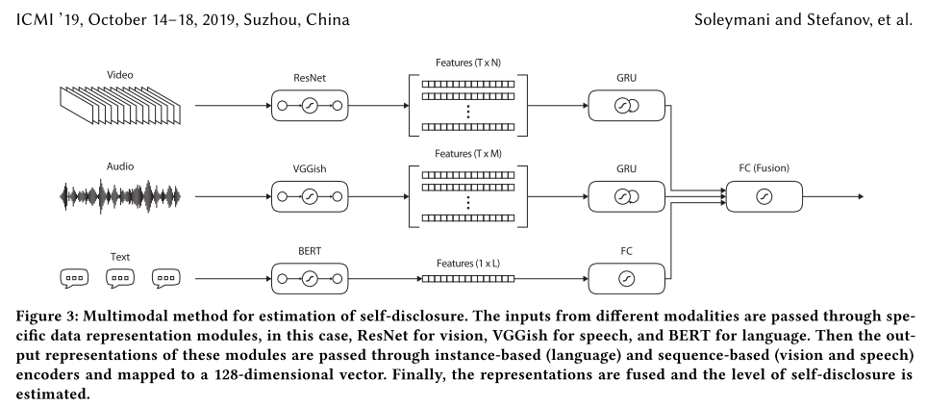
Example – https://dl.acm.org/doi/10.1145/3340555.3353737

Slide 36
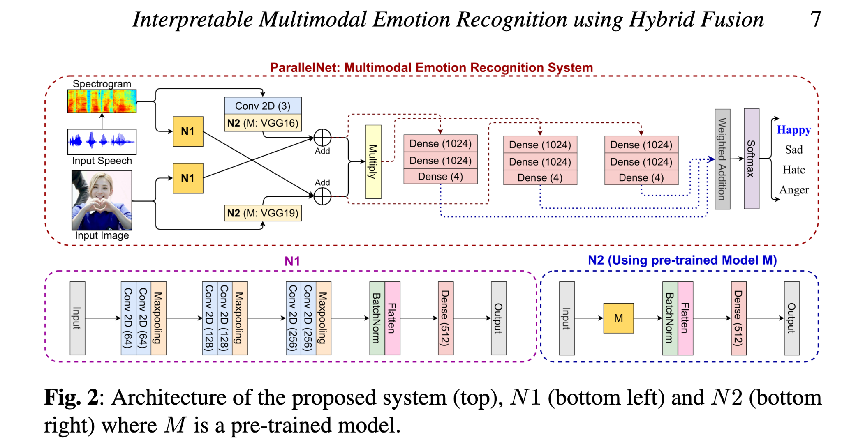
Example – https://arxiv.org/pdf/2208.11868.pdf

Slide 37
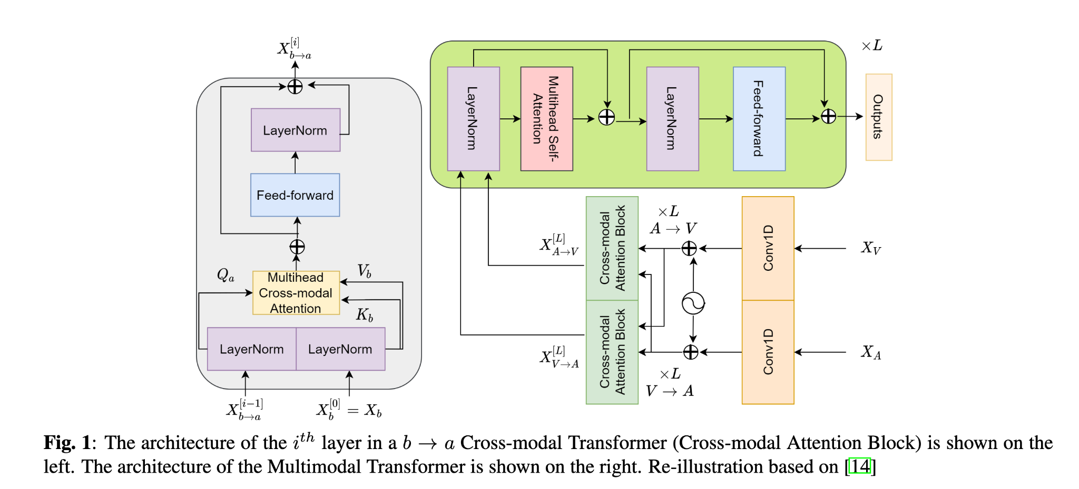
Notes:
chrome-extension://oemmndcbldboiebfnladdacbdfmadadm/https://arxiv.org/pdf/2201.09165.pdf
A PRE-TRAINED AUDIO-VISUAL TRANSFORMER FOR EMOTION RECOGNITION
Combine X_V and X_A

Slide 38
Interpretability
Hand-crafted (openSmile) vs end-to-end (openFace) using correlation or feature extraction
NID (feed forward)
SincNet (Convolutional filters)
Audio Inputs
Fusion
Outputs
Classification of emotion
Interpretability of what led to what classification
Visual Inputs
Data engineering - Extract feature sets (with openSMILE)
MFCC
PLP-CC
Prosody (Pitch + Loudness)
Etc
Notes:
Interpretability can be before or after classification

Slide 39
MIDTERM REPORT
INPUT:
MSP-IMPROV (audio)
OUTPUT:
Classification of emotion (Angry, Happy, Neutral, Sad)
Notes:
Interpretability can be before or after classification

Slide 40
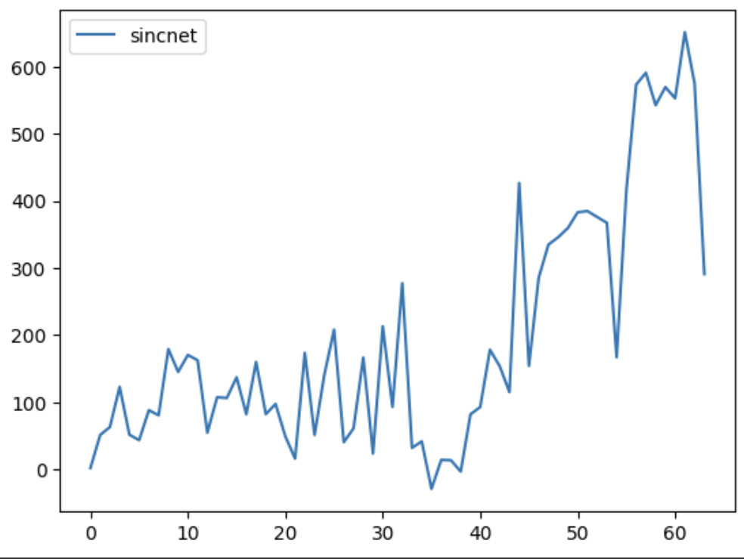
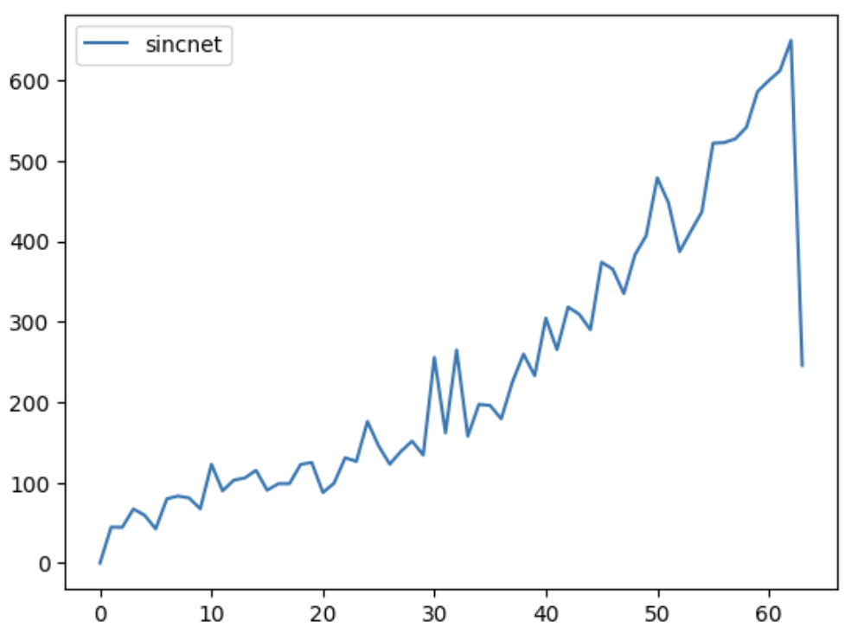
<CREMA-D>
<MSP-T>
Pitch
Pitch
Formants
Formants
Notes:
Interpretability can be before or after classification

Slide 41
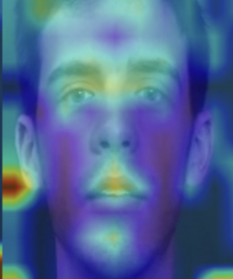
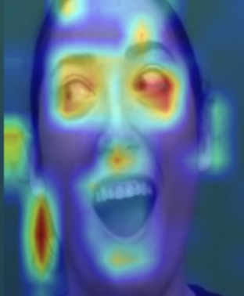
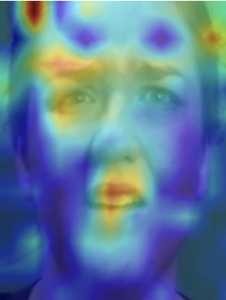
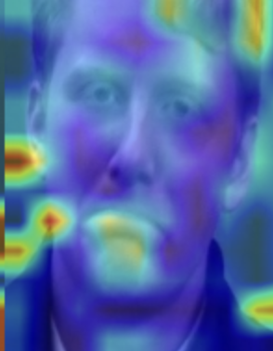


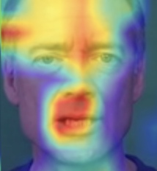
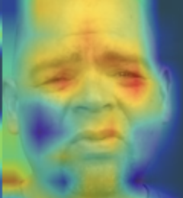
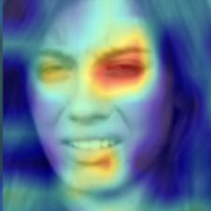

<MSP-T>
Neutral
Happy
Angry
Sad
<CREMA-D>
Neutral
Happy
Angry
Sad
Disgust
Fear
Notes:
Interpretability can be before or after classification

Slide 42
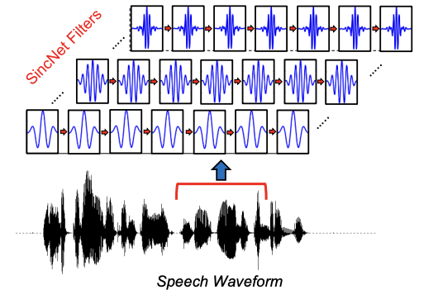
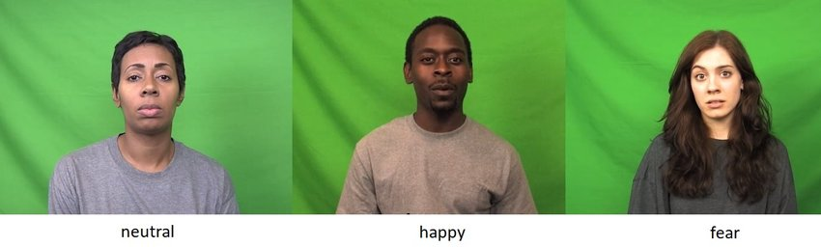
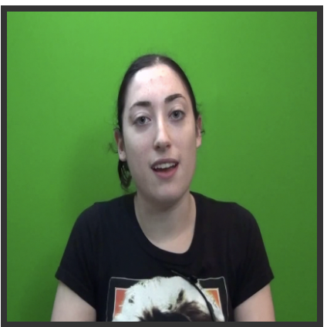
Bayesian NN
<Adding Explainability>
Cross modal interaction diagnose via EMAP
LeakyReLU
<Adding Interpretability>
SincNet Filter Analysis
<Adding Explainability>
Visual Explanation via GradCAM
Layer Norm
Deep Feature Extraction
Fusion
IF:
EMAP score is higher than threshold,
Take bimodal prediction
ELSE:
Take more confident unimodal prediction
Video
Notes:
Interpretability can be before or after classification

Slide 43








Method - preprocessing
<Audio>
<Crop Silence>
<Shared Fixed Length>
<Video>
<Image frames>
<Crop Faces>
Notes:
For Fusion method, we will use contextual bimodal attention fusion method
We will perform classification task using Bayesian Neural network to achieve interpretability by capturing uncertainty in our prediction

Slide 44
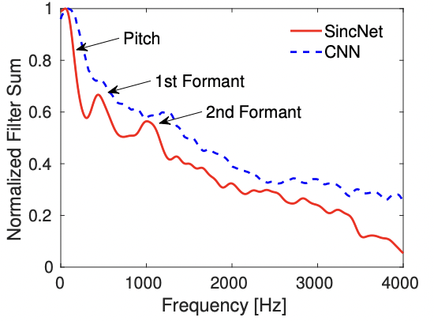
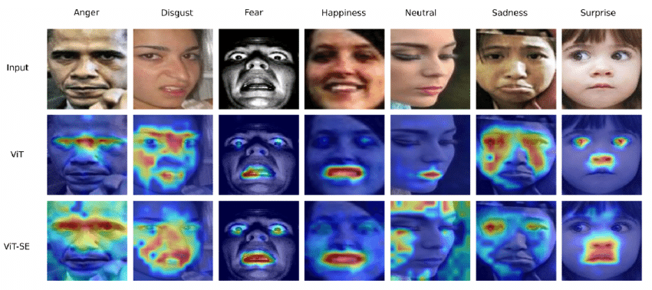
<Unimodal Classification>
<Adding Interpretability>
SincNet Filter Analysis
SincNet Filter + Convolutional Filters
Cross modal interaction diagnose via EMAP
<Bimodal Classification>
<Early/Late Fusion>
Deep Feature Extraction using ViT
<Unimodal Classification>
<Adding Explainability>
Visual Explanation via GradCAM
Video
Notes:
Interpretability can be before or after classification

Slide 45
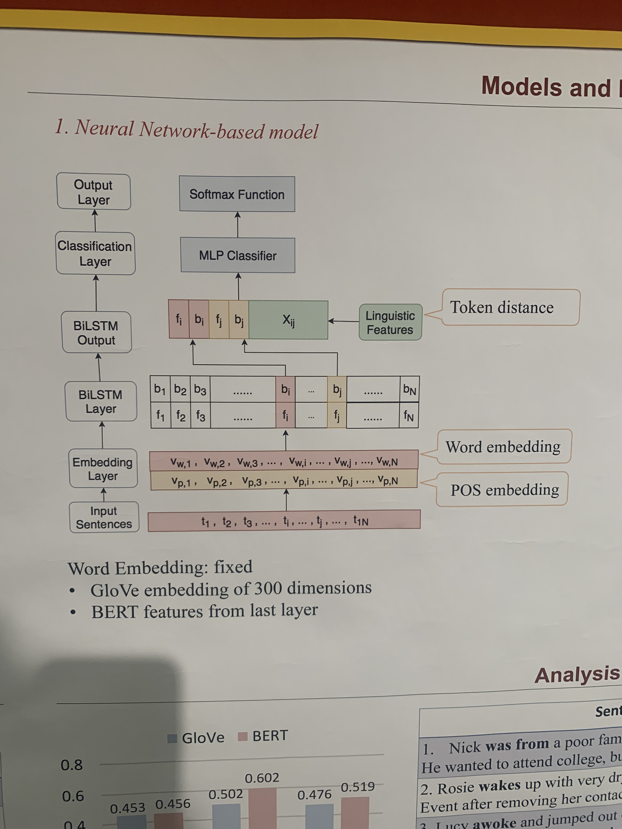
Contextualized Word Embedding Enhanced Event Temporal Relation Extraction for Story Understanding Rujun Han Mengyue Liang Bashar Alhafni Nanyun Peng
Notes:
Found on the 9th floor at ISI outside the restrooms

